Slide 1
Avalon Switch Fabric

Slide 2
Avalon Switch Fabric
Proprietary interconnect specification used with Nios II
Principal design goals
  Low resource utilization for
  bus logic
  Simplicity
  Synchronous operation
Transfer Types
  Slave Transfers
  Master Transfers
  Streaming Transfers
  Latency-Aware Transfers
  Burst Transfers
Nios II Processor
Switch PIO
32-Bit
Nios II
Processor
Address (32)
Read
Avalon Switch Fabric
Write
LED PIO
Data In (32)
Data Out (32)
7-Segment
LED PIO
IRQ
IRQ #(6)
PIO-32
ROM
(with Monitor)
UART
Timer
User-Defined Interface

Slide 3
Avalon Switch Fabric
Custom-Generated for Peripherals
  Contingencies are on a Per-Peripheral Basis
  System is Not Burdened by Bus Complexity
SOPC Builder Automatically Generates
  Arbitration
  Address Decoding
  Data Path Multiplexing
  Bus Sizing
  Wait-State Generation
  Interrupts
Notes:
Avalon is unique in that it is custom generated for your system.
Not every node needs to handle every contingency, so it doesn’t.
Only complicated peripherals need complicated interfaces.
System is not burdened by unnecessary complexity.

Slide 4
Avalon Master Ports
Initiate Transfers with Avalon Switch Fabric
Transfer Types
  Fundamental Read
  Fundamental Write
All Avalon Masters Must Honor a waitrequest signal
Transfer Properties
  Latency
  Streaming
  Burst

Slide 5
Avalon Slave Ports
Respond to Transfer Requests from Avalon Switch Fabric
Transfer Types
  Fundamental Read
  Fundamental Write
Transfer Properties
  Wait States
  Latency
  Streaming
  Burst

Slide 6
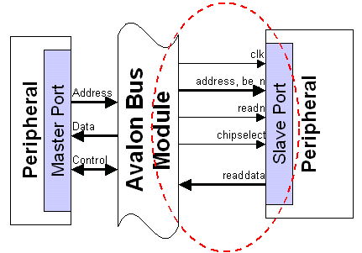
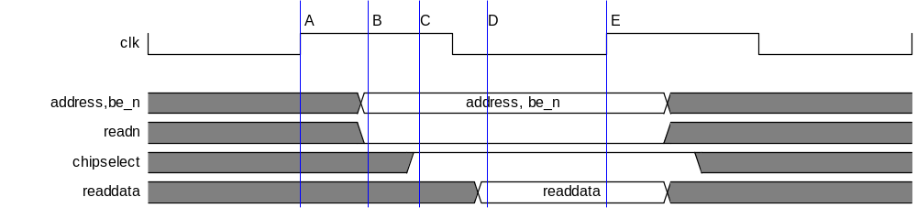
Slave Read Transfer
0 Setup Cycles
0 Wait Cycles
Notes:
We will describe some data transfers on the next few slides – <may want to mention that we get much deeper into the Avalon Switch Fabric in the Designing A S.O.P.C. class…>

Slide 7
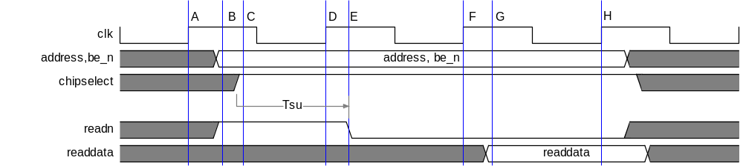
Slave Read Transfer with Wait States
1 Setup Cycle
1 Wait Cycle

Slide 8
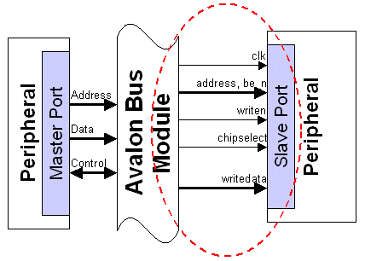
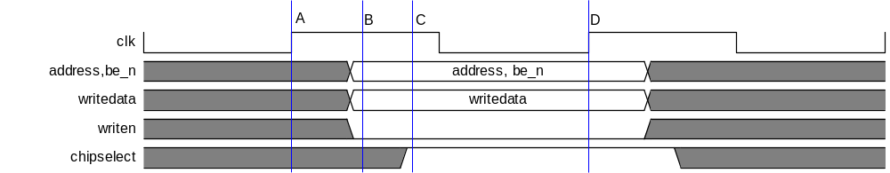
Slave Write Transfer
0 Setup Cycles
0 Wait Cycles
0 Hold Cycles

Slide 9
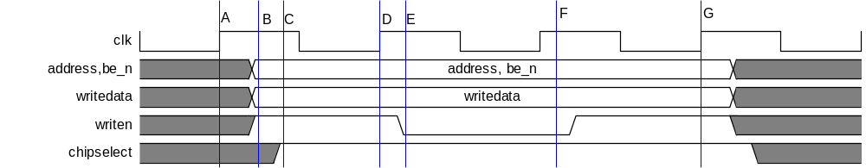
Slave Write Transfer with Wait States
1 Setup Cycle
0 Wait Cycles
1 Hold Cycle

Slide 10
Multiple Clock Domains Supported
Master
Clock Domain 1
Master
Clock Domain 2
Master
Clock Domain 1
Avalon Switch Fabric
CDX
CDX
Arbiter
Avalon Switch Fabric
Slave
Clock Domain 2
Slave
Clock Domain 2
Slave
Clock Domain 2
Slave
Clock Domain 2
CDX = Clock Domain Crossing Logic (inserted automatically by SOPC Builder)

Slide 11
Multi-Clock Domain Support
Master
Clock Domain 2
Master
Clock Domain 1
Master
Clock Domain 1
Master
Clock Domain 1
CDX
CDX
Arbiter
Arbiter
CDX
Avalon Switch Fabric
Avalon Switch Fabric
Slave
Clock Domain 3
Slave
Clock Domain 2
CDX = Clock Domain Crossing Logic

Slide 12
User-Defined Custom Peripherals
What if I need to add a peripheral not included with the Nios II system?
  user wants to add own peripheral to perform some kind of proprietary function or perhaps a standard function that is not yet included as part of the Nios kit
  Expand or accelerate system capabilities
We are now going learn how to connect our own design directly to the Nios II system via Avalon
  As many peripherals contain registers we could also have chosen to connect to a PIO rather than directly to the bus

Slide 13
Creating Avalon Slave
No Need to Worry about Bus Interface
Implement Only Signals Needed
Peripherals Adapted to by
Avalon Switch Fabric
Timing Handled Automatically
Fabric Created for You
Arbiters Generated for You
Avalon Switch Fabric
Register File
User Logic
Concentrate Effort on
Peripheral Functionality!
Notes:
The SOPC Builder methodology lets you forget about the bus interface.
You can focus on the functionality of the system peripherals. (the fun part)
Avalon adapts to create the optimal interface for each peripheral.
The bus logic & timing is automatically handled for you.

Slide 14
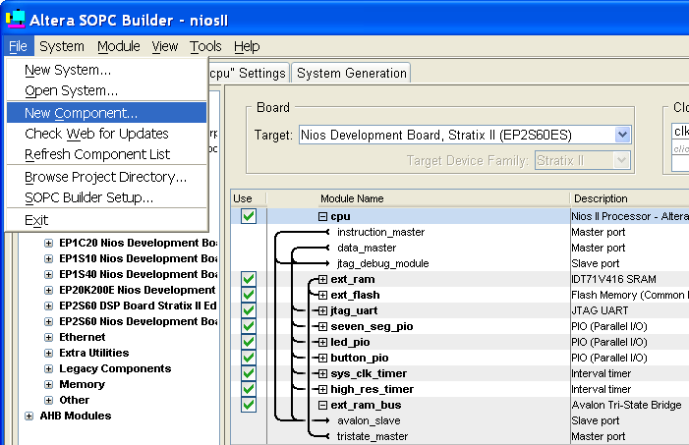
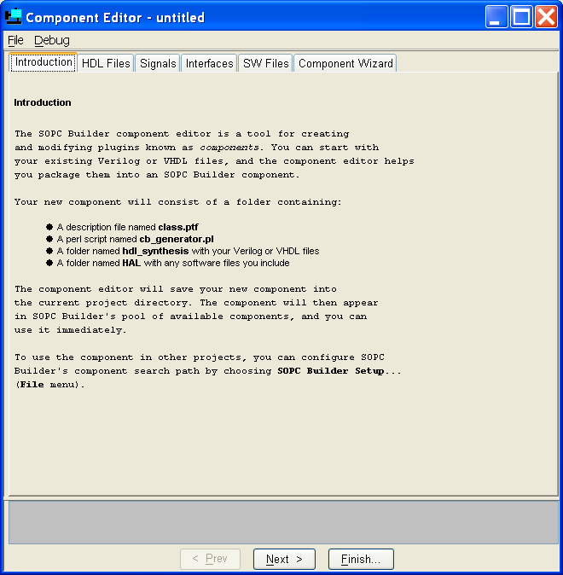
New Component Editor

Slide 15
Creates Interface
Connect to Existing HDL or board component
Map into Nios II Memory Space
Can be “Inside” or “Outside” Nios II System
I/O
I/O
Nios II
CPU
Nios II
CPU
I/O
I/O
Avalon
I/O
Avalon
I/O
I/O
I/O
Interface
to User
Logic
External
User
Peripheral
Internal
User
Peripheral
Nios II System
Module
Nios II System
Module

Slide 16
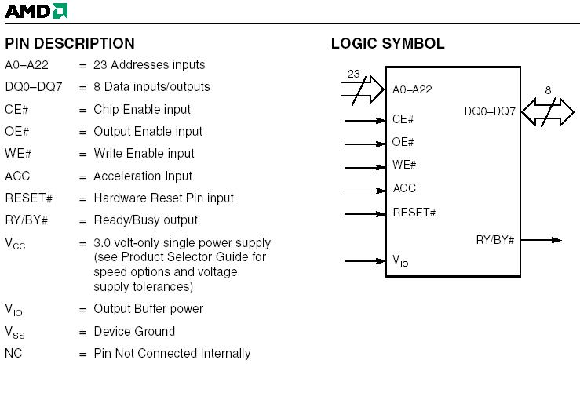
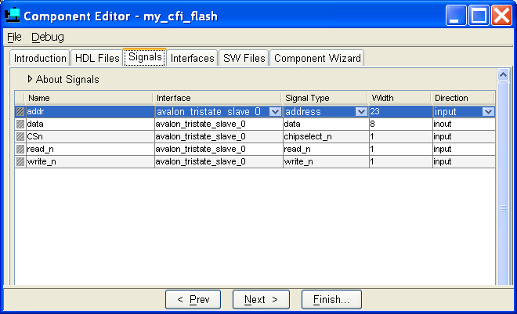
Create External Component Interface
To communicate with off-chip peripherals
Base interface type on data sheet
AMD29LV065AD CFI Flash Chip

Slide 17
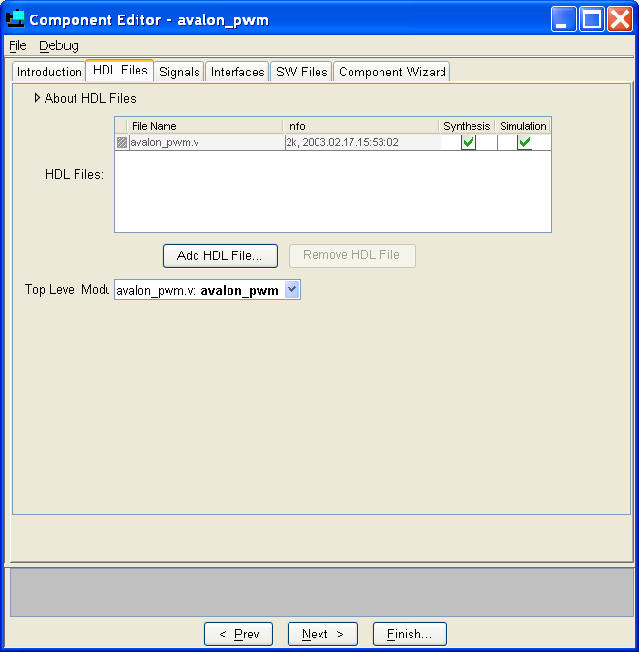
Or Add HDL Files
For peripheral that has been encoded for FPGA

Slide 18
Tri-State Peripherals
Require Tri-State Bridge
  Available as an SOPC Builder component
Tri-State peripheral is defined by the presence of a bi-direction data port
Off-chip peripherals do not have to be tri-state
Off Chip Peripheral
Avalon
Tri-State Bridge
Interface to User Logic
Nios II
Processor
FPGA

Slide 19
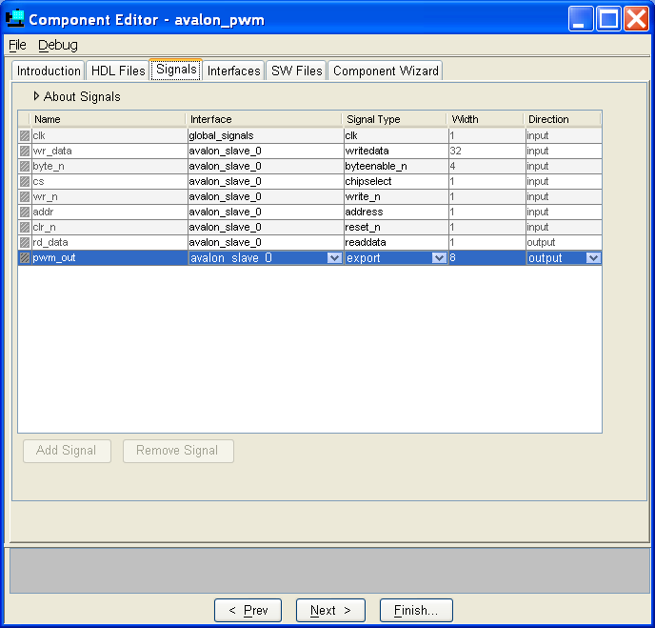
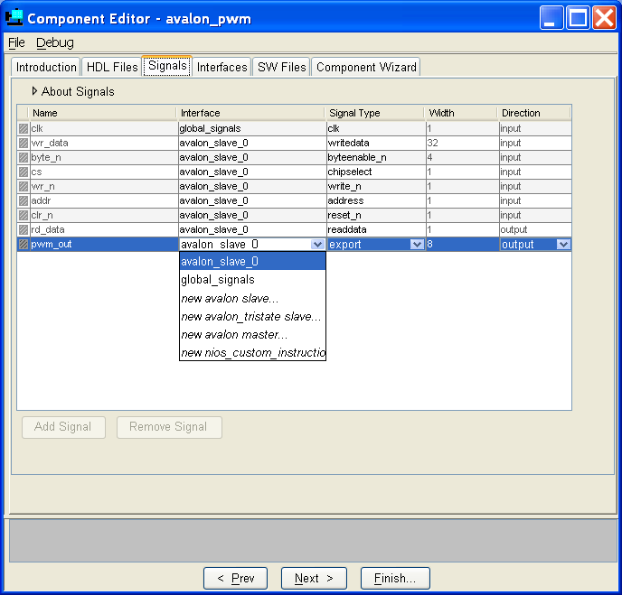
Define Component Signals
Automatically populates port table from design files
Enter port type here
Can also define ports manually

Slide 20
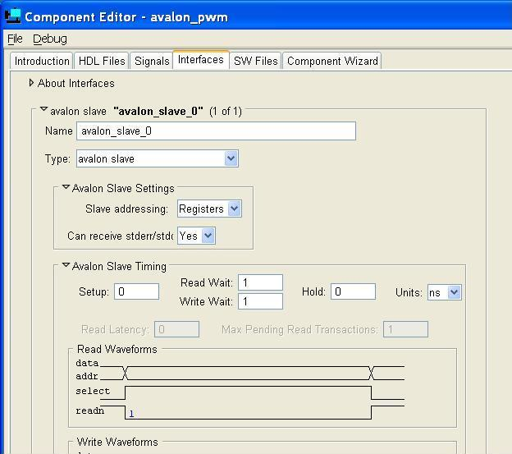

Define Interface for Each Signal Type
Choose interface type Register Slave uses native alignment, Memory Slave uses dynamic alignment
Control Read and Write Timing Add wait and hold states View waveforms

Slide 21
Address Alignment – Narrow Slave
32-Bit
Nios II Processor
Avalon
Peripheral Registers
Base
Base + 0x1
Base + 0x2
Base + 0x3
Base + 0x4
32
aa
bb
cc
dd
ee
8
8 Bit Peripheral
Dynamic Address Alignment (set as Memory Slave)
  LD from Base + 0x0: dd cc bb aa
  LD from Base + 0x4: uu uu uu ee
Native Address Alignment (set as Avalon Register Slave)
  LD from Base + 0x0: uu uu uu aa
  LD from Base + 0x4: uu uu uu bb
  LD from Base + 0x8: uu uu uu cc

Slide 22
Address Alignment – Narrow Master
32-Bit
Nios II Processor
Avalon
32
Memory Contents
Base
Base + 0x8
Base + 0x16
77 66 55 44 33 22 11 00
ff ee dd cc bb aa 99 88
?? ?? ?? ?? ?? ?? ?? ??
64
64 Bit Memory
Dynamic Address Alignment
  LD from Base + 0x0: 33 22 11 00
  LD from Base + 0x4: 77 66 55 44
  LD from Base + 0x8: bb aa 99 88
Native Address Alignment
  LD from Base + 0x0: 33 22 11 00
  LD from Base + 0x4: bb aa 99 88
  LD from Base + 0x8: ?? ?? ?? ??
  High bytes are unobtainable – warning issued

Slide 23
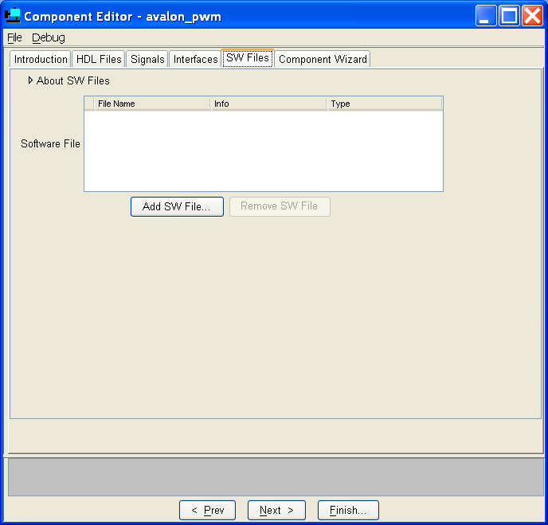
Add Software Files
ie. Header files and drivers
Notes:
01/10/05 – Note: as of today, this feature does not seem to work properly. (DWO)

Slide 24
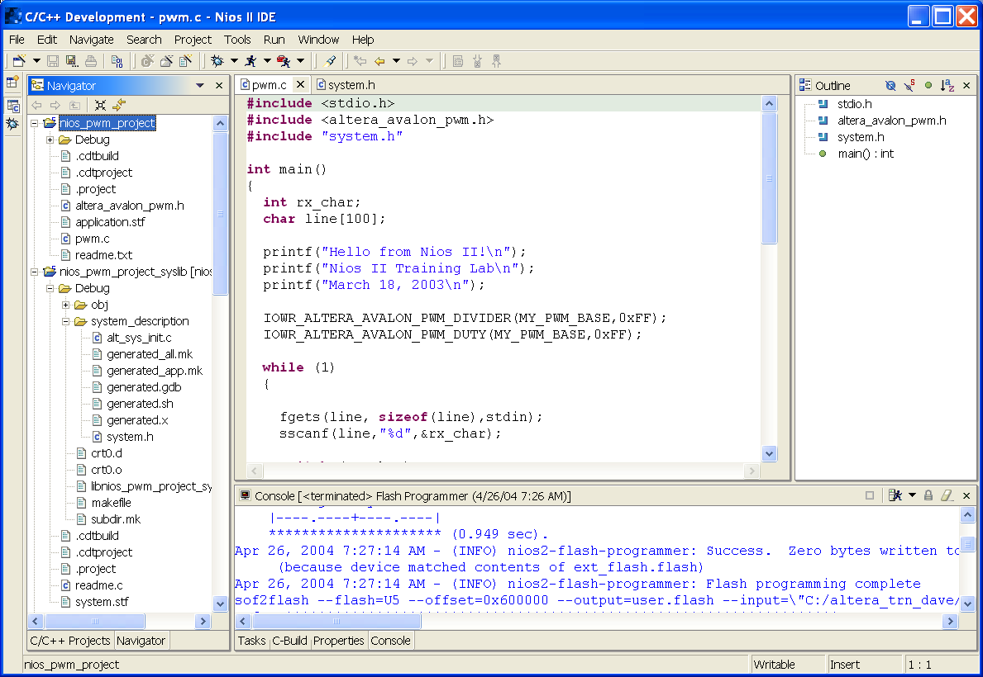
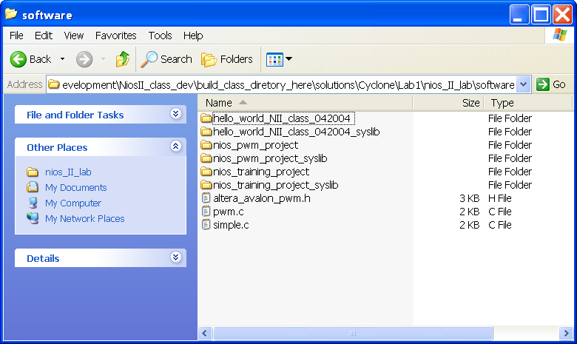
Add Software Files
Header file and drivers can also be added directly to Application Project
Notes:
You drag and drop the code to run the peripheral as well as the header file right into the project directory in the Navigator.

Slide 25
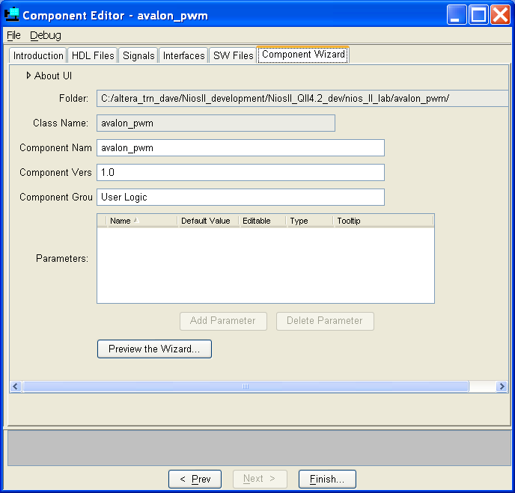
Create Component Wizard
Publish and create a wizard for your component
Fill in fields
Add component to SOPC Builder portfolio
Can add parameterizing capability to component

Slide 26
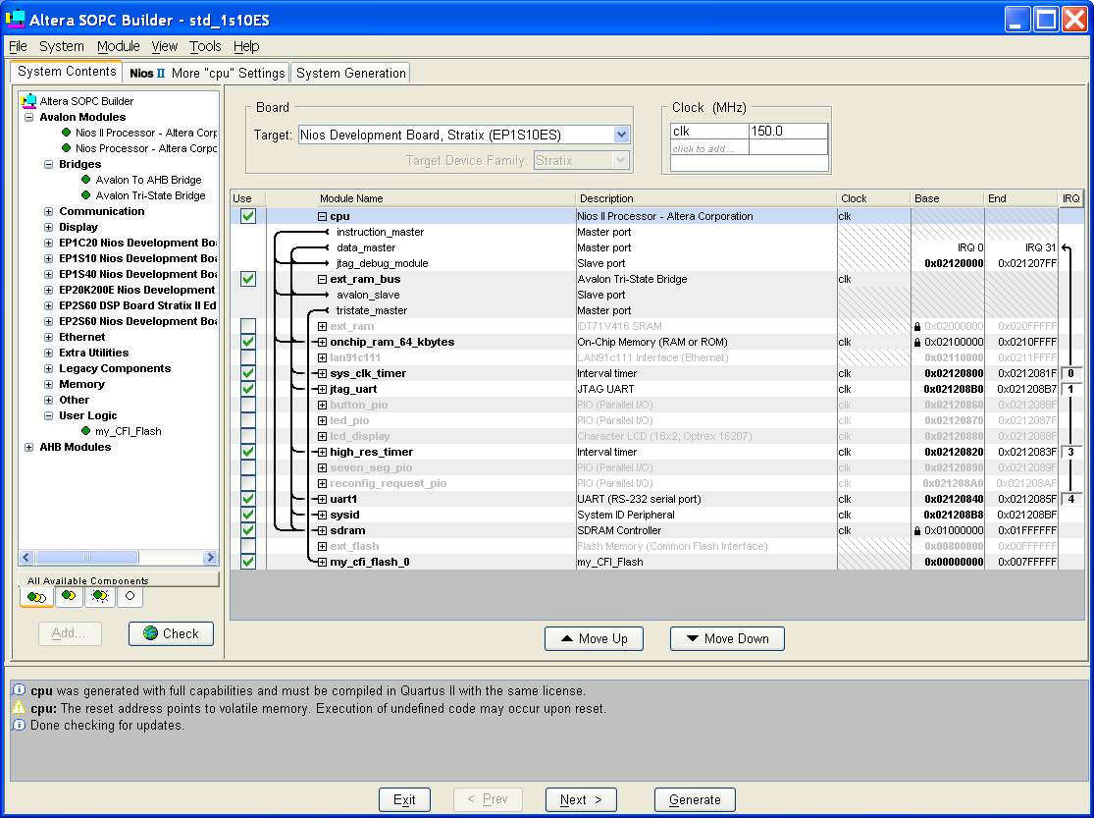
Add Component to SOPC System
Default location is the User Logic folder

Slide 27
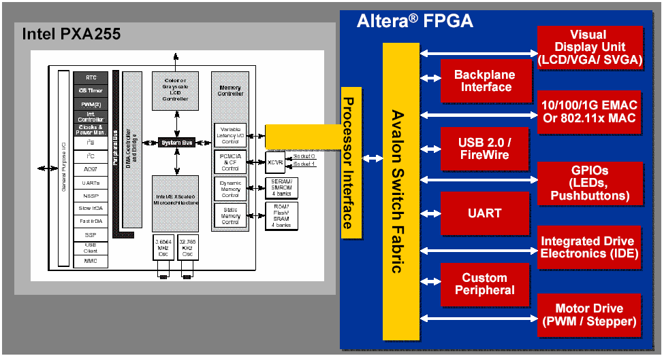
Intel PXA255 Example

Slide 28
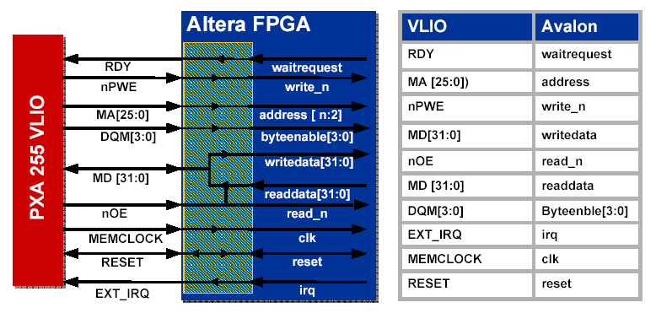
VLIO as an Avalon Master Port VLIO
Intel PXA255 Variable Latency I/O (VLIO) Uses a Bi-Directional Data Path, RDY Signal to Add Wait States
Interface Separates DATA into Read Data & Write Data Paths

Slide 29
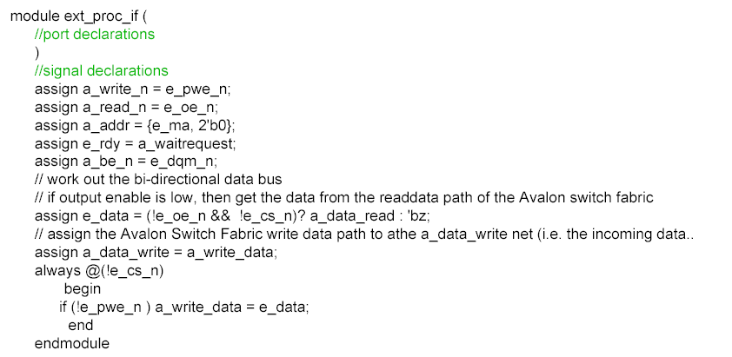
Relevant Verilog Code to Relevant Verilog Code to Implement

